Slide 1






Implementation of a Hadoop Multi-Node Cluster and Spark Framework
for Image Compression
JPEG2000

Slide 2

Abdelatif Mekri
Halima Nfidsa
Imad Eddine Boukader
Mihoubi Nahla Yasmine

Slide 3
Table of contents
01
02
03
04
05
Introduction
Technical background
Code and running
Results
Discussion

Slide 4

01
Introduction

Slide 5

Introduction
In the era of Big Data, efficiently managing and processing large volumes of image data has become increasingly critical. This project addresses this challenge by implementing a distributed image compression system utilizing two powerful big data technologies: Hadoop and Spark.

Slide 6
Introduction
Importance of Compression
Objectives
- Compression helps in handling large volumes of data efficiently.
- It reduces the space required to store files.
- It improves the speed of data transfer across networks.
Reduces irrelevance and redundancy of the image data to be able to store or transmit data in an efficient form

Slide 7
02
Technical Background

Slide 8
Workflow Steps
Installation and Configuration
1
2
Image Storage in HDFS
3
Image Compression Using and

Slide 9
Installation and Configuration
1. Install Java
2. Install Hadoop
3. Install Spark
4. Configure Spark with Hadoop
Required for both Hadoop & Spark.
Download, extract, set environment variables, configure core-site.xml & hdfs-site.xml, format HDFS, and start services.
Download, extract, set environment variables, start standalone cluster, and verify installation.
Configure Spark to use YARN, enable event logging, and start the history server.

Slide 10
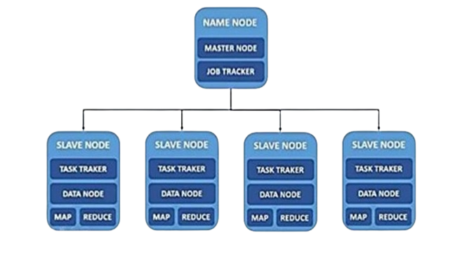
Installation and Configuration

Slide 11
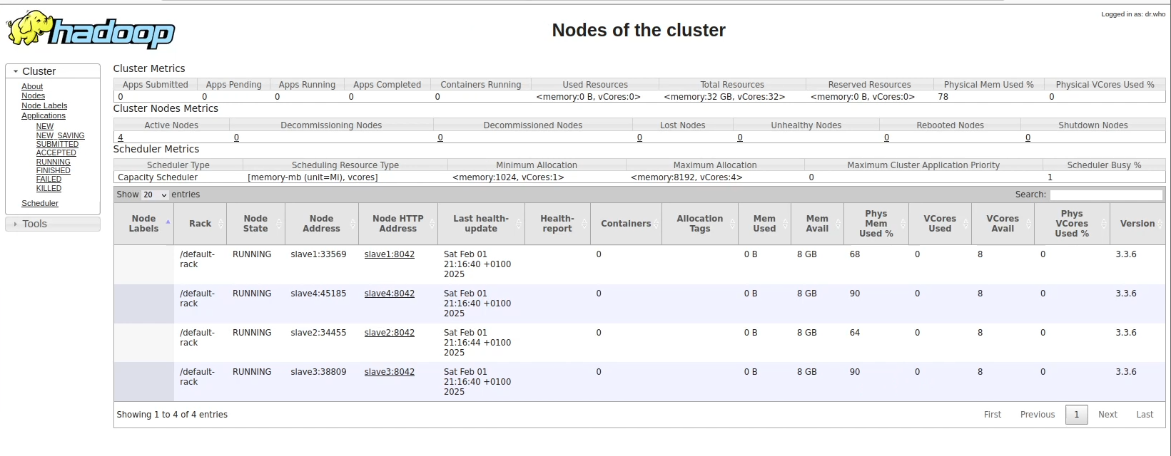
Installation and Configuration

Slide 12
image Compression
Spark
MapReduce
Implementing image Compression
}
Apache Spark
Hadoop

Slide 13
Difference between approaches
The primary difference between MapReduce on Hadoop and Hadoop & Spark lies in Step 4: Parallel Processing.

Slide 14
Difference between approaches
Hadoop MapReduce (Method 1):
Hadoop & Spark (Method 2):
Mapper: Processes the image blocks (DCT and quantization).
Reducer: Aggregates the results and applies encoding.
Hadoop handles the initial block splitting and DCT transformation using MapReduce.
Spark then processes the quantization, encoding, and potentially the aggregation using its in-memory processing capabilities.

Slide 15
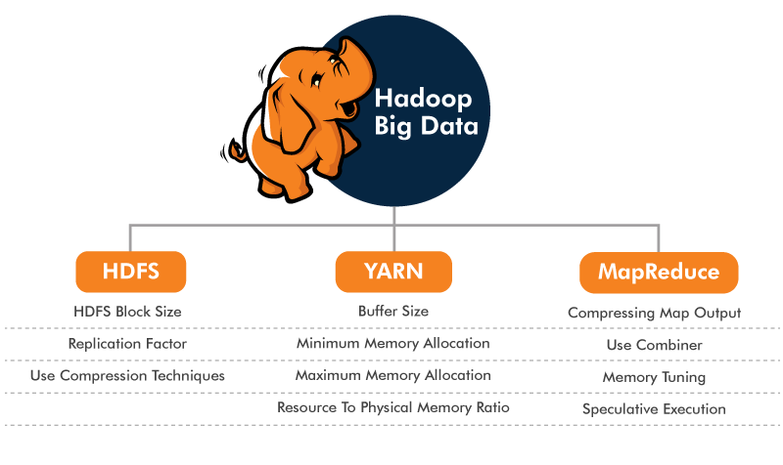
image Compression using hadoop (Map-Reduce)

Slide 16

image Compression using hadoop (Map-Reduce)
MAP
Sort-shuffle
Reduce
ImgC 01
Img 01
task
sort
ImgC 02
Img 02
Map Output
task
Reduce output
. . .
sort
. . .
. . .
ImgC N-1
Img N-1
ImgC N
Img N
task N
HDFS
HDFS

Slide 17
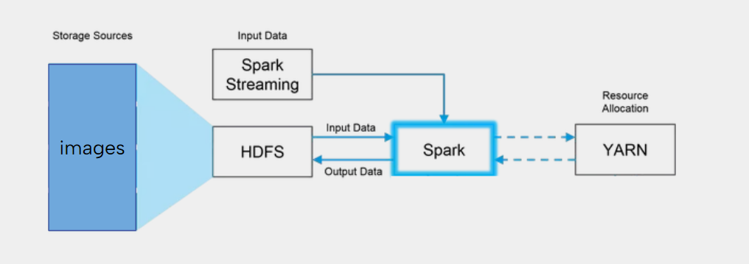

image Compression using hadoop and spark

Slide 18
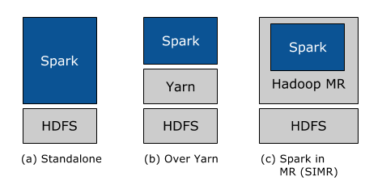
image Compression using hadoop and spark
Spark runs alongside Hadoop MapReduce with manually allocated resources
Allows Spark to run on YARN without additional installation, integrating seamlessly into the Hadoop ecosystem;
Enables users without YARN to launch Spark jobs within MapReduce for quick experimentation

Slide 19
03
Code and running

Slide 20
1 approach :
Hadoop & Spark
st

Slide 21



Installing the libraries
Libopenjp2-7dev

Slide 22

Implementing the solution
1. Initialize SparkSession for connecting to Hadoop cluster
- Set application name ("JPEG2000 Compression")
- Set master to "yarn" for cluster management
- Create Spark context (sc)
2. Define base path on HDFS for storing compressed images
hdfs_output_base = "hdfs://master:9000/user/hadoop/compressed_images"
3. Get Hadoop FileSystem handle from Spark for interacting with HDFS
conf = sc._jsc.hadoopConfiguration()
fs = sc._jvm.org.apache.hadoop.fs.FileSystem.get(conf)
Path = spark._jvm.org.apache.hadoop.fs.Path # Java Path class
4. Define a function `save_to_hdfs(filename, data)`:
- Create full path for the image on HDFS
- Open an output stream to the target HDFS location
- Write the binary data (compressed image) to HDFS
- Close the stream
5. Define a function `compress_image(image_bytes)`:
- Try to open image from binary data
img = Image.open(io.BytesIO(image_bytes))
- Compress the image using JPEG2000 format
output_buffer = io.BytesIO()
img.save(output_buffer, format="JPEG2000")
- Return compressed image as bytes
return output_buffer.getvalue()
- Handle errors if any
6. Define the input path for images stored in HDFS
input_path = "hdfs://master:9000/user/hadoop/input_images"
7. Load images from HDFS as binary files using Spark's `binaryFiles` function
images = sc.binaryFiles(input_path)

Slide 23
Implementing the solution
8. Map over the loaded images:
- Compress each image using `compress_image`
compressed_images = images.mapValues(lambda data: compress_image(data))
- Store compressed data paired with the image filename
9. Collect the results back to the driver (assuming dataset is small enough)
results = compressed_images.collect()
10. Loop through the collected results:
- For each image, extract the filename
- Save compressed data to HDFS using `save_to_hdfs`
11. Stop the SparkSession to release resources
spark.stop()

Slide 24
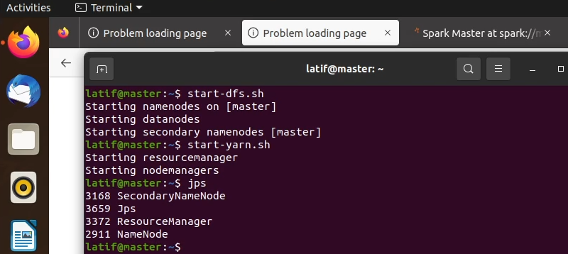
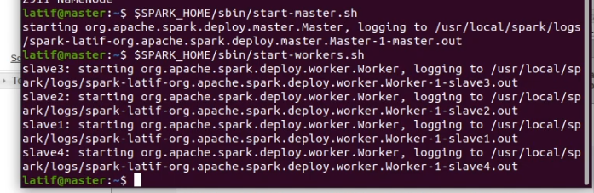
Starting hadoop and spark
From the master node we start the HDFS and the YARN;
-Start the Hadoop Distributed File System (HDFS): start-dfs.sh
-Start the YARN resource manager: start-yarn.sh
From the master node, we run both commands:
-To start the master node
$SPARK_HOME/sbin/start-master.sh
- To start slaves (workers) nodes
$SPARK_HOME/sbin/start-workers.sh

Slide 25
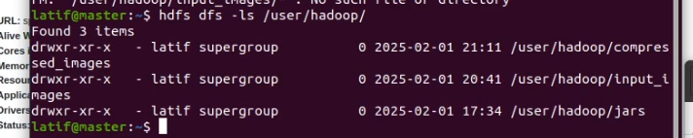
Check the HDFS
Checking if the input_images and compresed_images folders exist in the HDFS , if not to be created using :
-hdfs dfs -mkdir -p /user/hadoop/compressed_images
-hdfs dfs -mkdir -p /user/hadoop/input_images

Slide 26

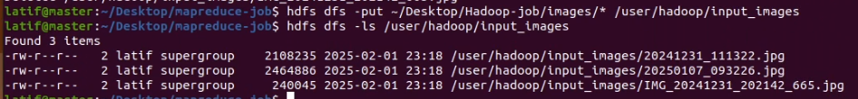
Upload the images to the designated folder in HDFS
Using the command below allows the upload of the files from the local machine to the HDFS system: hdfs dfs -put ~/Desktop/Hadoop-job/images/* /user/hadoop/input_images
Job submission
spark-submit command, it communicates with the cluster manager ( YARN) to allocate resources on available nodes.
spark-submit --master yarn --deploy-mode cluster Desktop/Hadoop-job/jpeg2000_compression.py

Slide 27
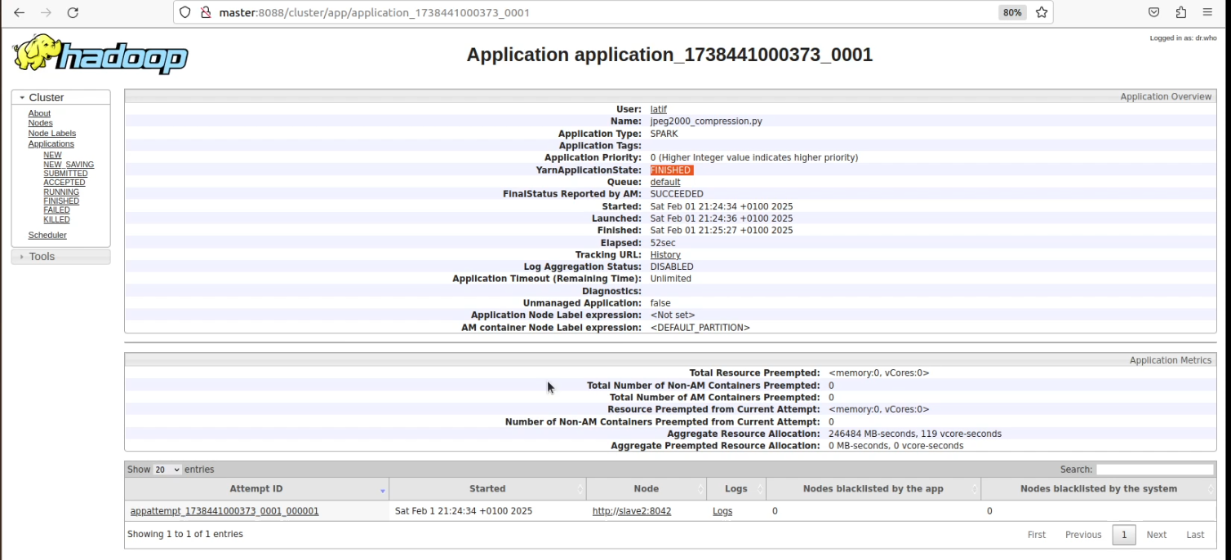
Running and Waiting for job

Slide 28
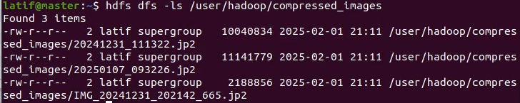
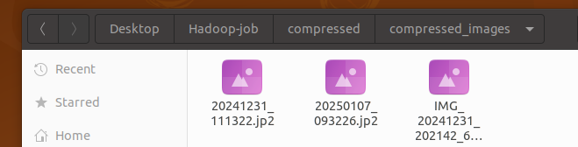
Retrieving results
We can check the results of the job by checking the designated folder for saving the results on the HDFS, by using the command
hdfs dfs -ls /user/hadoop/compressed_images
The results can be saved on one of the local machines just by running
hdfs dfs -get /user/hadoop/compressed_images ~/Desktop/Hadoop-job/compressed

Slide 29
1 approach :
Hadoop & Spark demo video
ST

Slide 31
2 approach :
Hadoop (Map-Reduce)
ND

Slide 32

Code
ImageCompressor.java
WholeFileninputFormat.java
WholeFileRecordReader.java
Notes:
Three parts of code were implemented supporting JPEG compression to assure the functionality of the map reduce job

Slide 33

ImageCompressor.java
ImageCompressMapper
Reads the image from BytesWritable.
Uses ImageIO to convert it to a BufferedImage.
Compresses the image to JPEG format with 50% quality.
Writes the compressed image data as output.
Main Method
Sets up a Hadoop MapReduce job.
Uses WholeFileInputFormat to read full image files.
Runs only the Mapper function (map-only job) with setNumReduceTasks(0).
Takes input and output paths as arguments
job
importance
This file contains:
ImageCompressMapper (Mapper class) → Responsible for compressing images.
Main method → Configures and runs the MapReduce job.
-Image compression reduces storage size while maintaining reasonable quality. -Efficient processing with a map-only job, ideal for large-scale distributed image compression
Key points

Slide 34
WholeFileRecordReader.java
job
Key points
importance
This custom record reader reads an entire file into memory and stores its contents as a BytesWritable object.
Reads the entire file into a byte array.
Stores the file path as the key (Text) and file content as the value (BytesWritable).
Ensures that each file is processed only once (processed flag).
Essential for handling binary files like images, ensuring the entire file is available for processing.

Slide 35
WholeFileInputFormat.java
job
Key points
importance
This custom input format ensures that each file is treated as a single input record instead of being split into smaller chunks
Extends FileInputFormat<Text, BytesWritable> to specify the input format.
Overrides isSplitable() → returns false, meaning that each file is processed as a whole.
Overrides createRecordReader() → provides a WholeFileRecordReader to read the file as a whole.
Ensures that image files are processed completely rather than split, which is crucial for image processing.

Slide 36
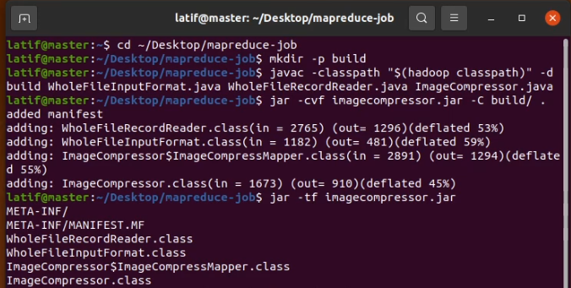
Compiling the java files
To prepare the previous files to be used in the job , the task of compiling them is assured by javac :
javac -classpath $(hadoop classpath) -d build/ WholeFileInputFormat.java WholeFileRecordReader.java ImageCompressor.java
After compilation , we need to build the jar that’s going to be introduced later on

Slide 37
From the master node we start the HDFS and the YARN;
-Start the Hadoop Distributed File System (HDFS): start-dfs.sh
-Start the YARN resource manager: start-yarn.sh
Checking if the input_images and compresed_images folders exist in the HDFS , if not to be created using
hdfs dfs -mkdir -p /user/hadoop/compressed_images
hdfs dfs -mkdir -p /user/hadoop/input_images
Using the command below allows the upload of the files from the local machine to the HDFS system
hdfs dfs -put ~/Desktop/Hadoop-job/images/* /user/hadoop/input_images
Starting hadoop
Check the HDFS
Upload the images to the designated folder in HDFS

Slide 38
Jobe submission
Hadoop jar command communicates with the cluster manager ( YARN) to allocate resources on available nodes.
hadoop jar imagecompressor.jar ImageCompressor /user/hadoop/input_images /user/hadoop/compressed_images

Slide 39
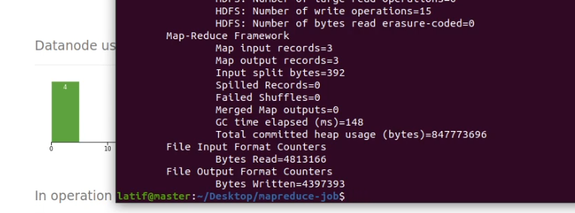

Running and waiting for job compilation
Downloading the output files
Using the command
hdfs dfs -get /user/hadoop/compressed_images ~/Desktop/mapreduce-job/compressed

Slide 40
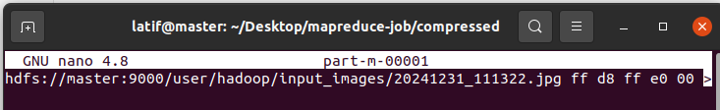
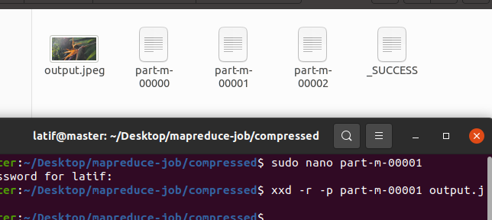
Fix the output file to see the results
Hadoop outputs images data in an incompatible format (e.g., hex or with extra metadata). This process ensures we get a clean binary JPEG file.
To visualise the file , we need to go through the following steps:
-open image using sudo nano
-remove the first line which can look something like
-use this after to reproduce
xxd -r -p part-m-00001 output.jpeg
And get something like this after :

Slide 41
2 approach :
Hadoop (Map-Reduce) Tuto Video
ND

Slide 43
04
Results

Slide 44
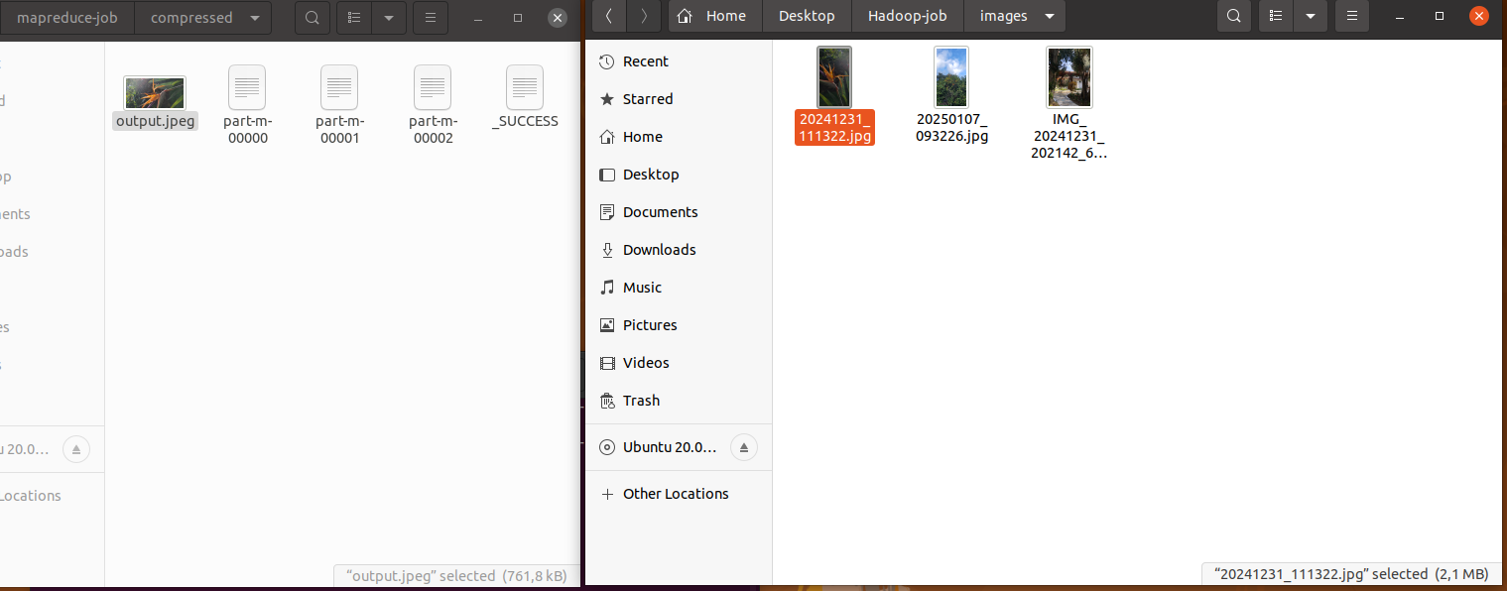
Folders of Input and output images

Slide 45
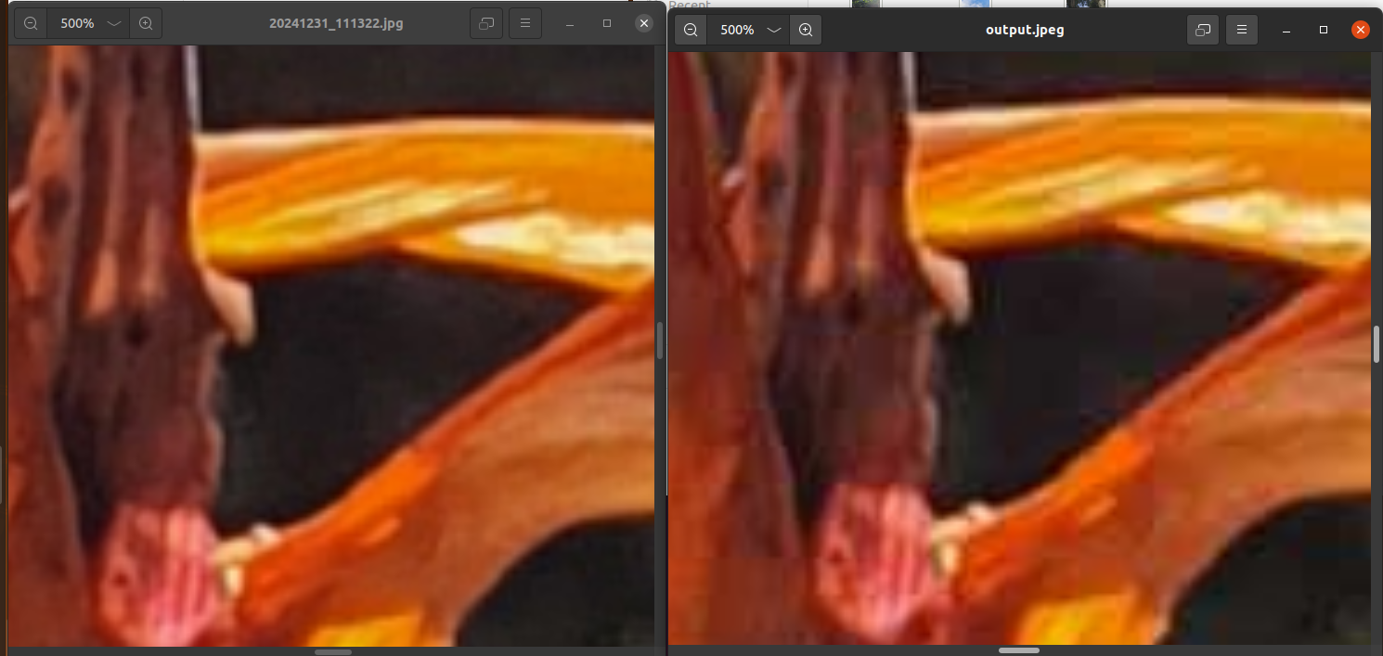
Input image VS Output images

Slide 46
2.1MB to 761.8KB
slight detail loss at over 400% zoom
high visual quality

Slide 47
Conclusion
This project showcases efficient JPEG compression using parallel processing with Hadoop MapReduce and Hadoop & Spark, combining DCT, quantization, and encoding for effective compression, while Spark accelerates performance and scalability.

Slide 48
Results

Slide 49
Results

Slide 50
Thank you for your attention

